Slide 1
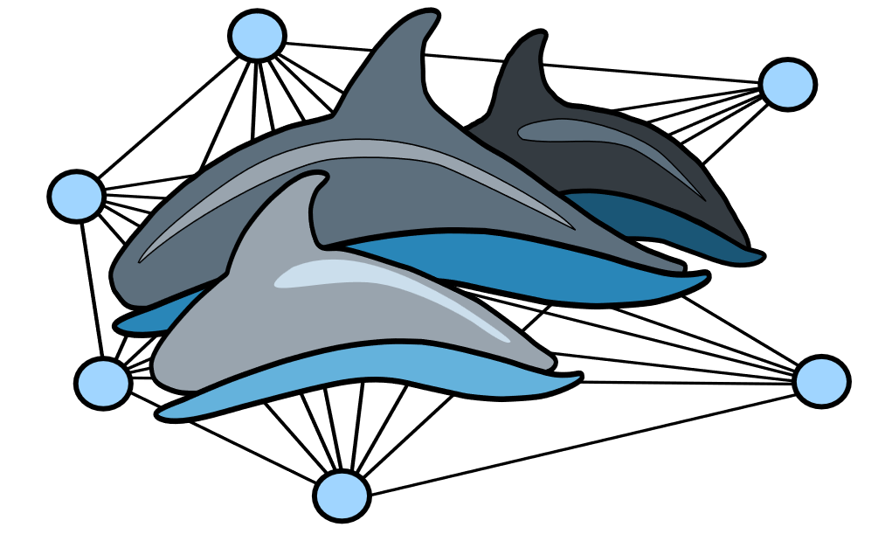
Establish temporal resolution for social analysis
Start
Red Tide
Create association index between dolphins in each study period
Human-Dolphin Interactions
Create social network for each study period
Use a null model approach to distinguish underlying structure of social network
Create similarity matrices of human-centric foraging and other biological/ecological predictors of association
Conclude
Build Bayesian GLMM with association as a function of human-centric foraging similarity, study period, and biological/ecological factors
Compare
Validate the results of the model with the social network social clusters
Compare

Slide 2
Establish temporal resolution for social analysis
Start
Red Tide
Create social network for each study period
Human-Dolphin Interactions
Calculate social centrality and average group size for each individual within each study period
Calculate the proportion of time each individual spent engaging in each human-centric tactics within each study period
Conclude
Build Bayesian LMM with social centrality as a function of time spent human-centric foraging between study periods
Validate the results of the model with the social network nodes
Validate results with average group size between human-centric foraging tactics

Slide 3
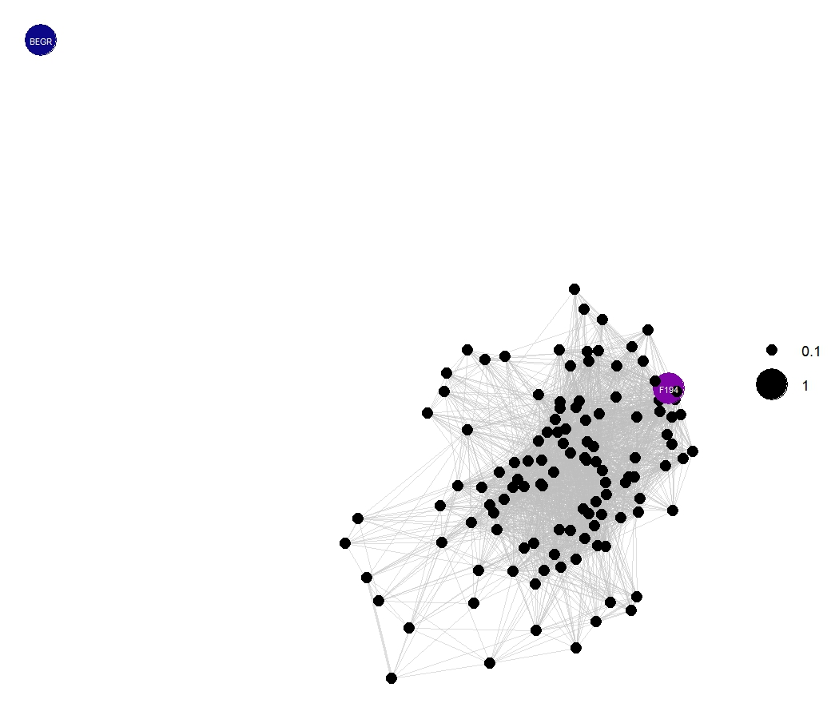
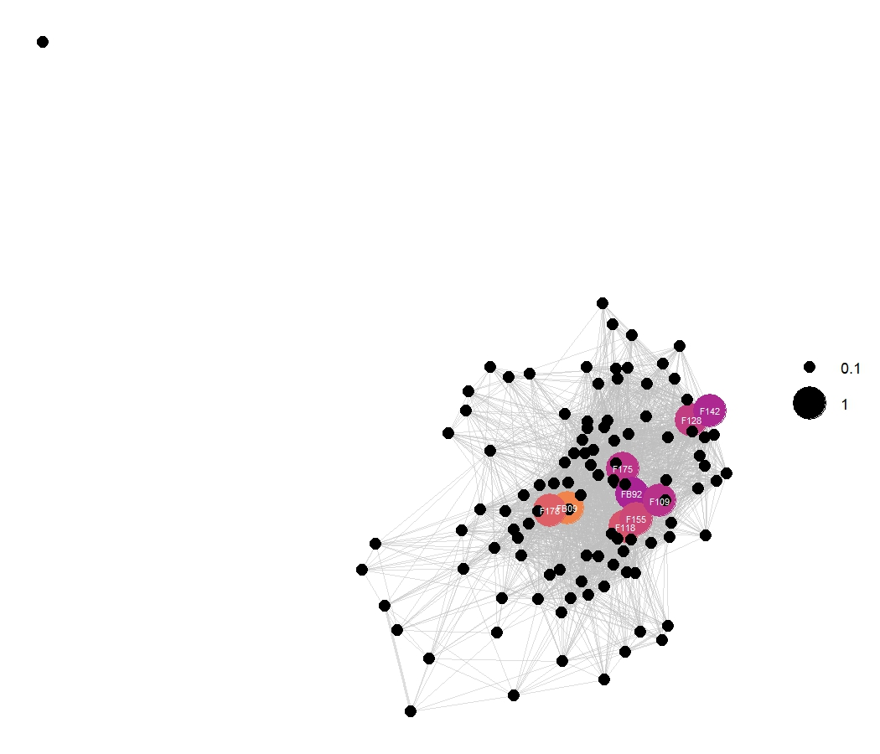
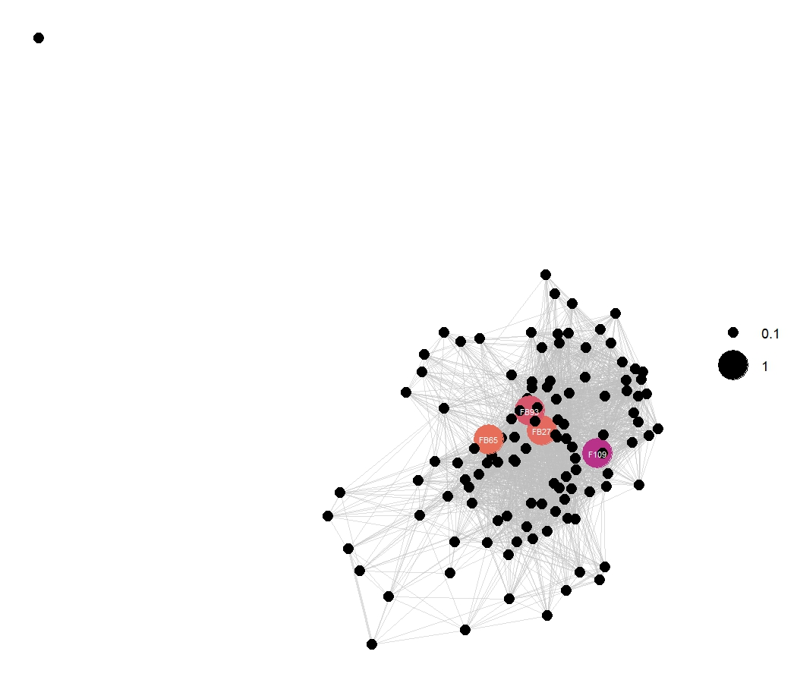
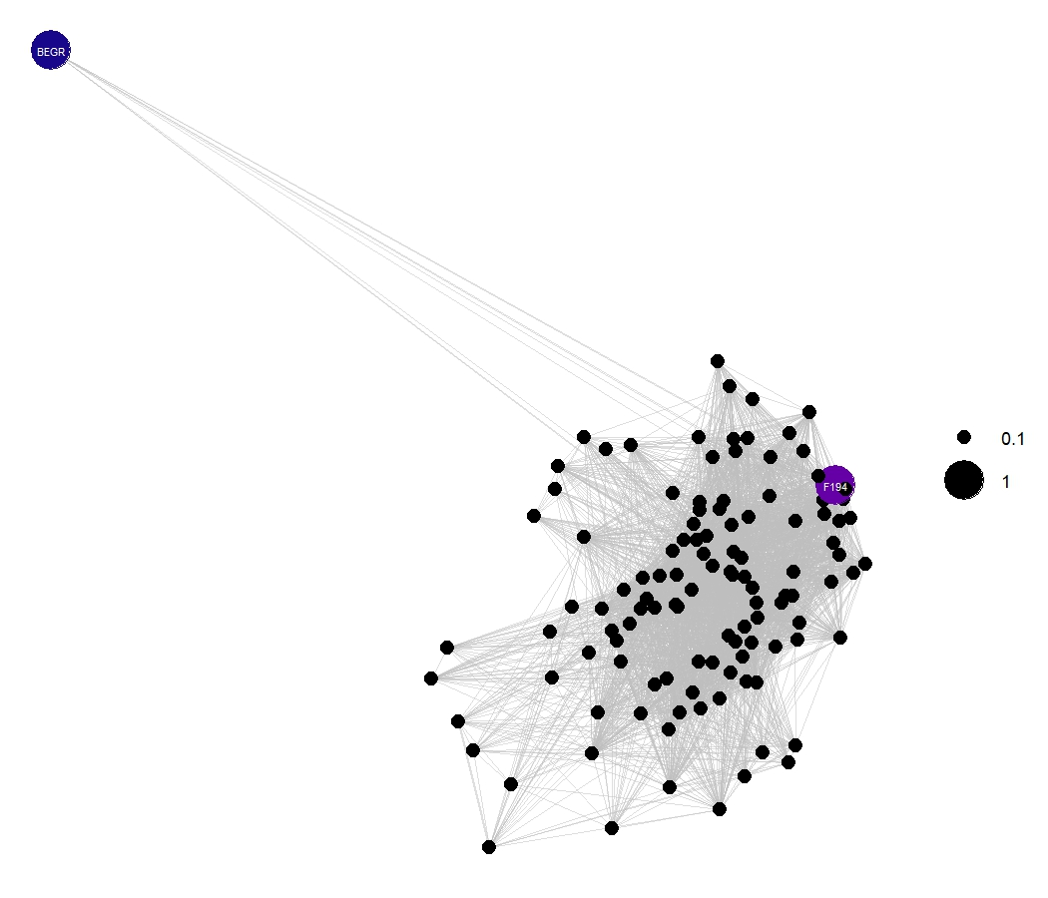
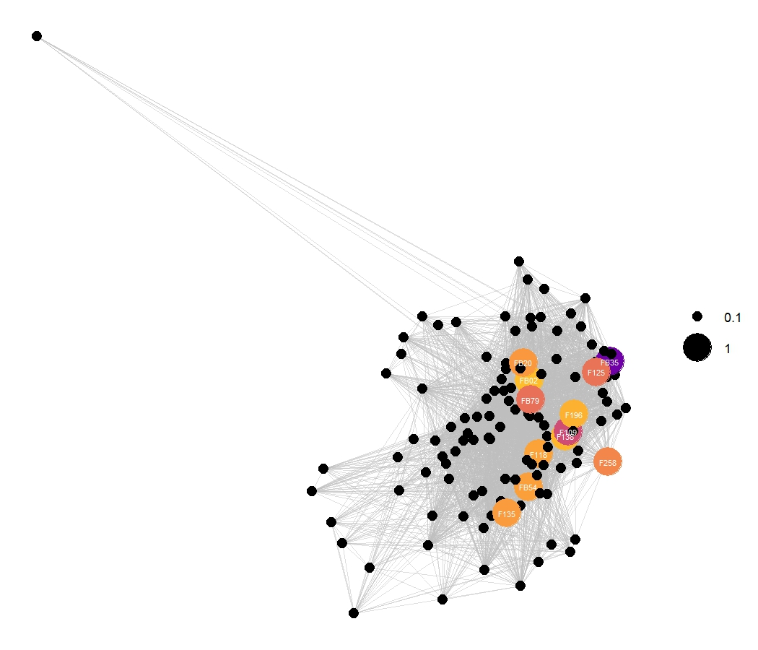
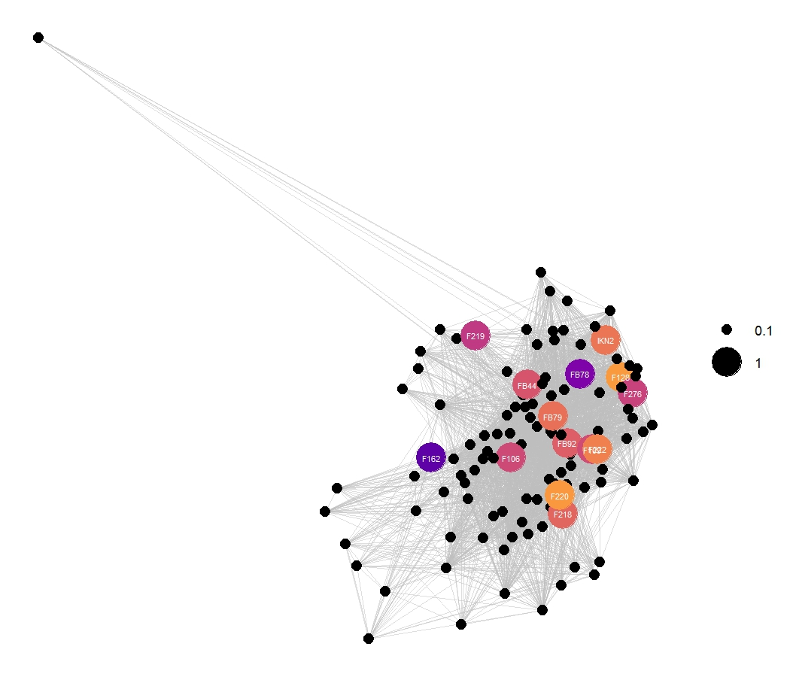
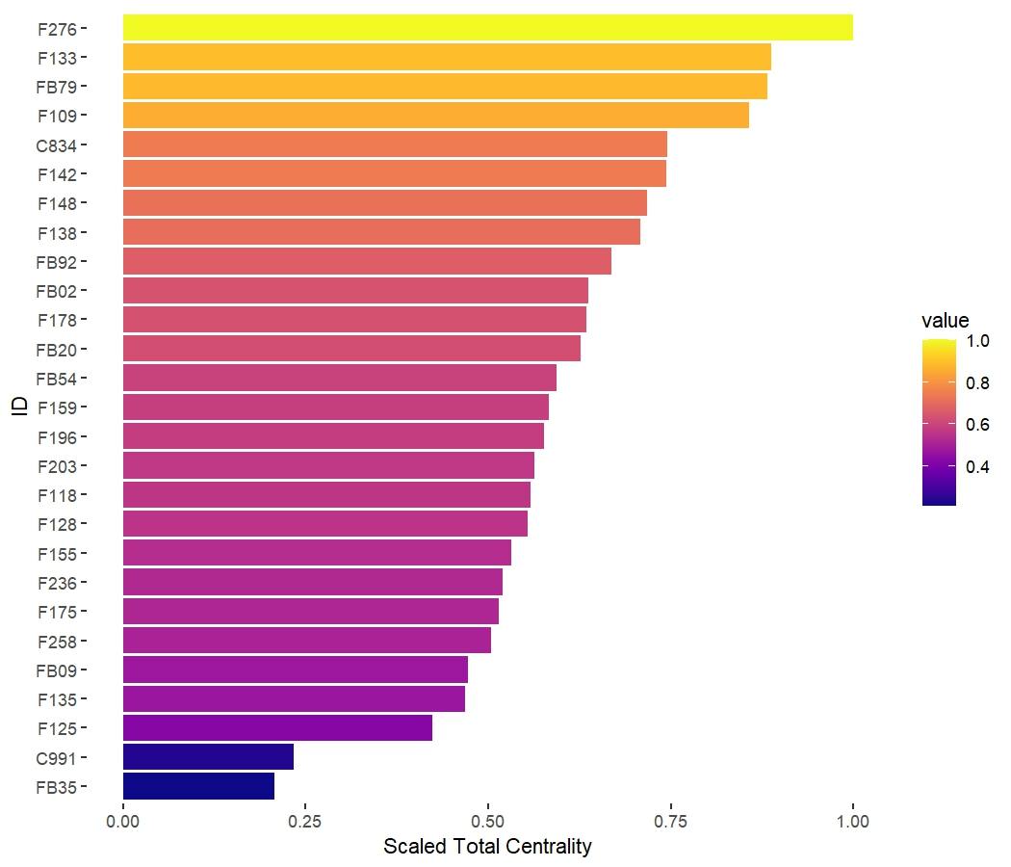
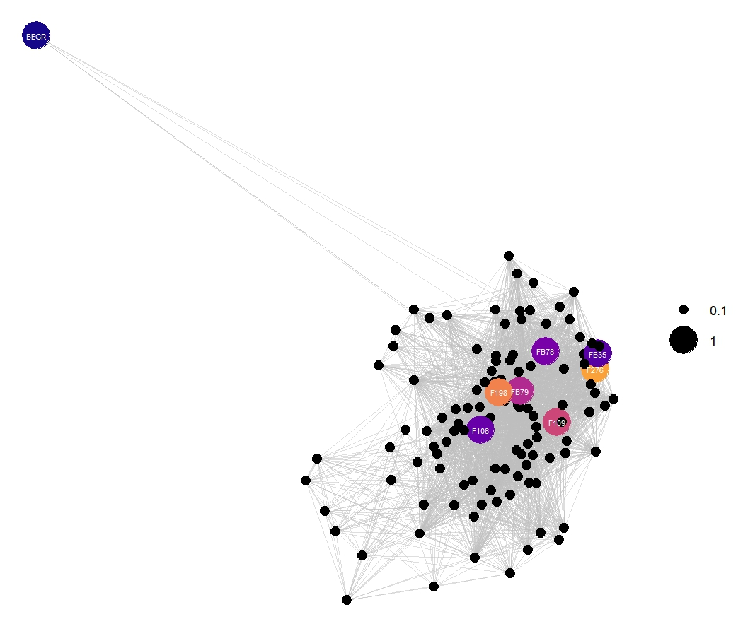
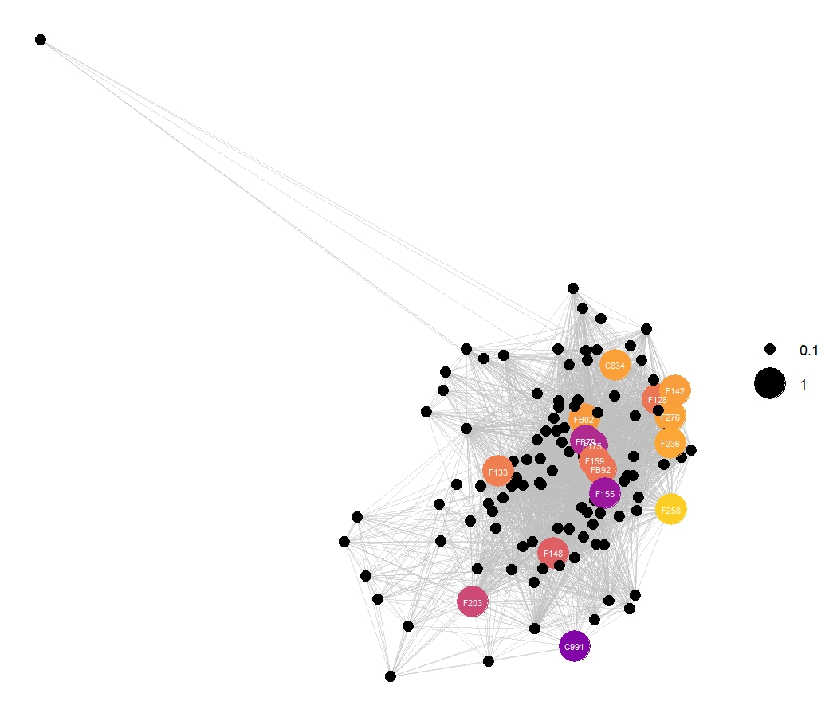
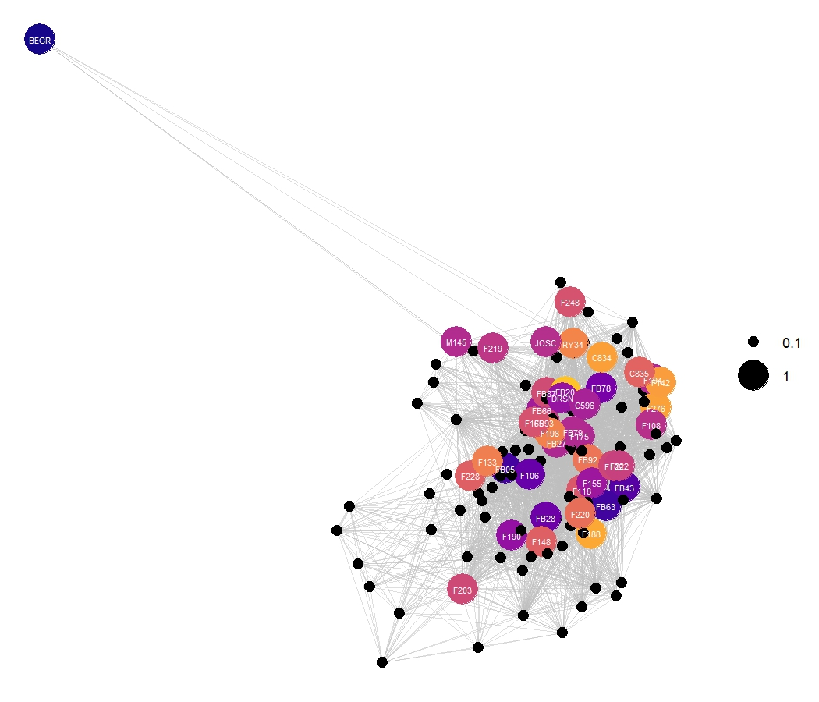
Beggars/Provisioners
Fixed gear foragers
Scavengers/Depredators
Before
Social
Centrality
During
After
Figure 1: Social network matrix displaying individuals that engage in three human-centric behaviors before, during and after red tide. Nodes are colored and enlarged if they were seen in the given period performing the given human-centric behavior. Colors correspond to the highlighted individual’s social centrality, a metric used to gauge an individual’s quality and quantity of social connectivity in their community.

Slide 4
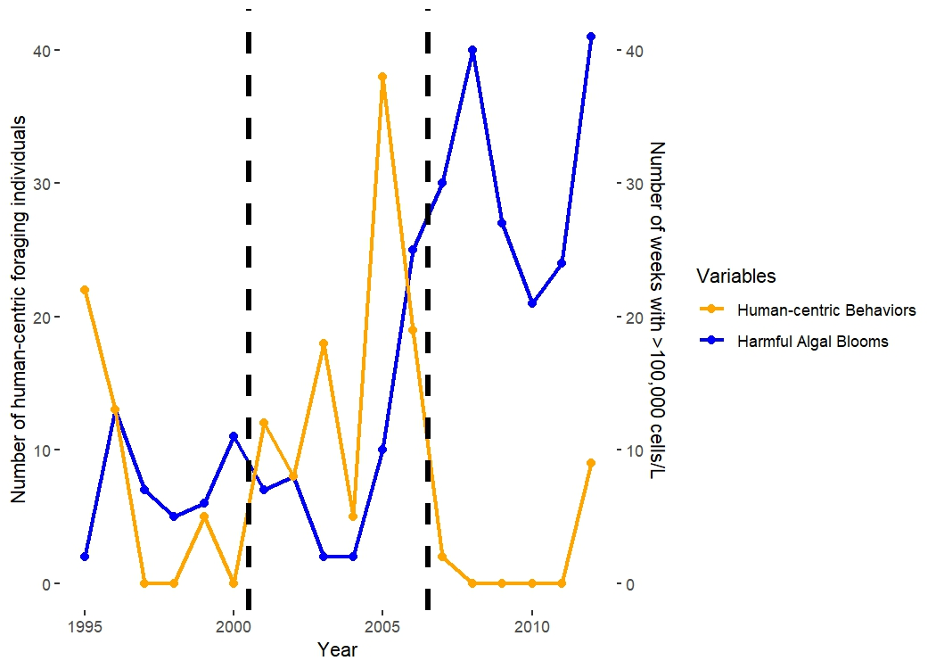
Before
Red Tide
12%
During
Red Tide
22%
After
Red Tide
41%

Slide 5
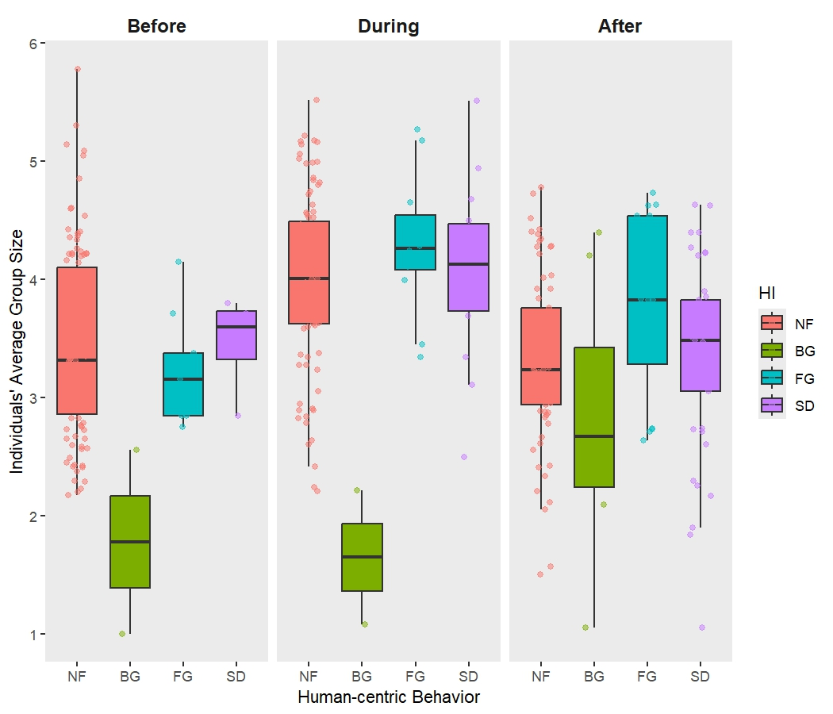
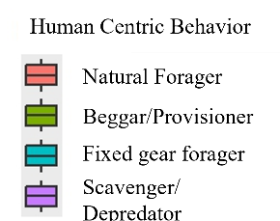
Before
1995 - 2000
During
2001 - 2006
After
2007 - 2012

Slide 6
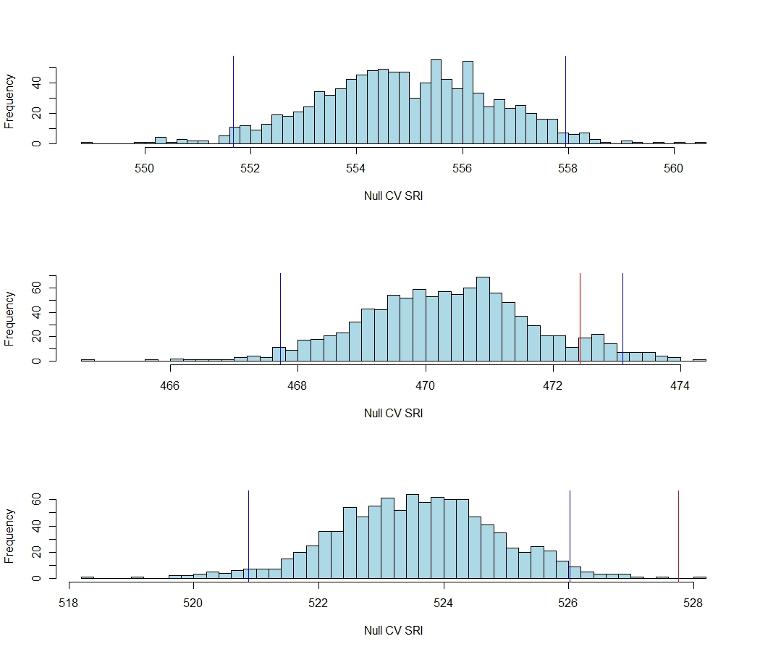
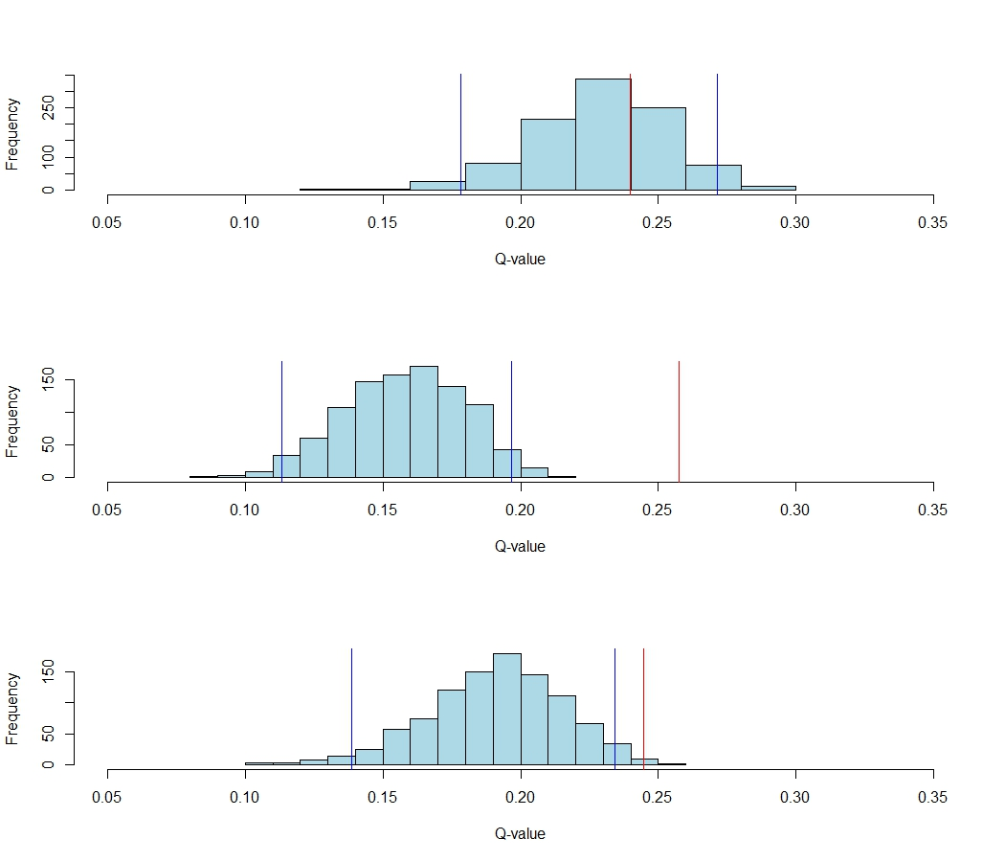
Observed
Before
Before
95% confidence interval
During
During
During
After
After

Slide 7
Positive effect on association
Predictors of Social Association
No effect on association
Negative effect on association
-1 0 1

Slide 8
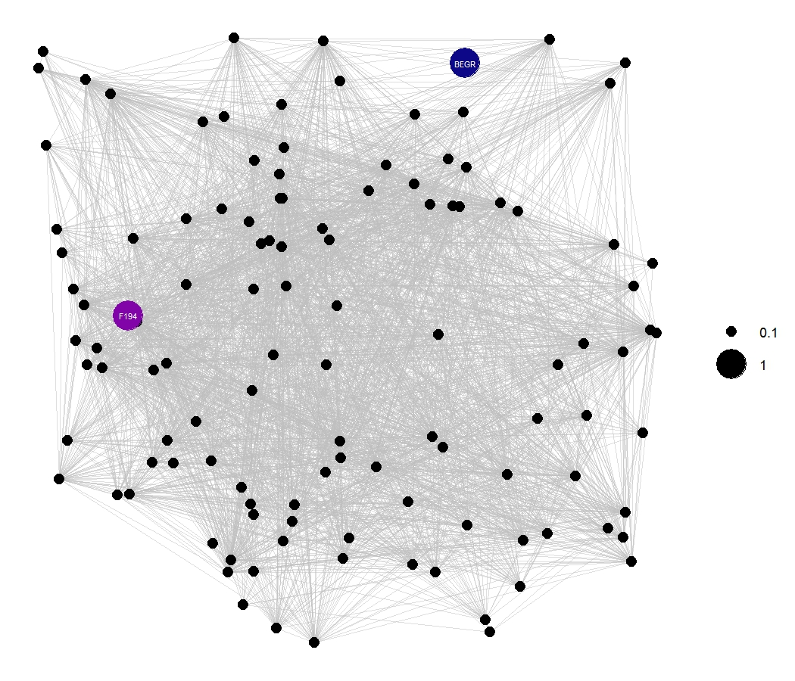
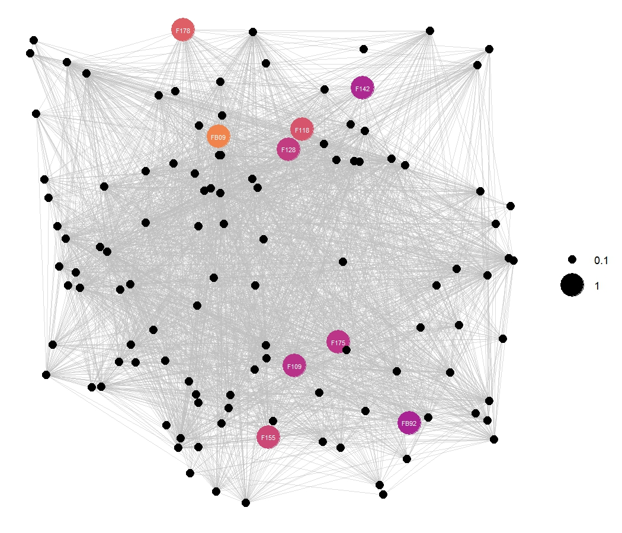
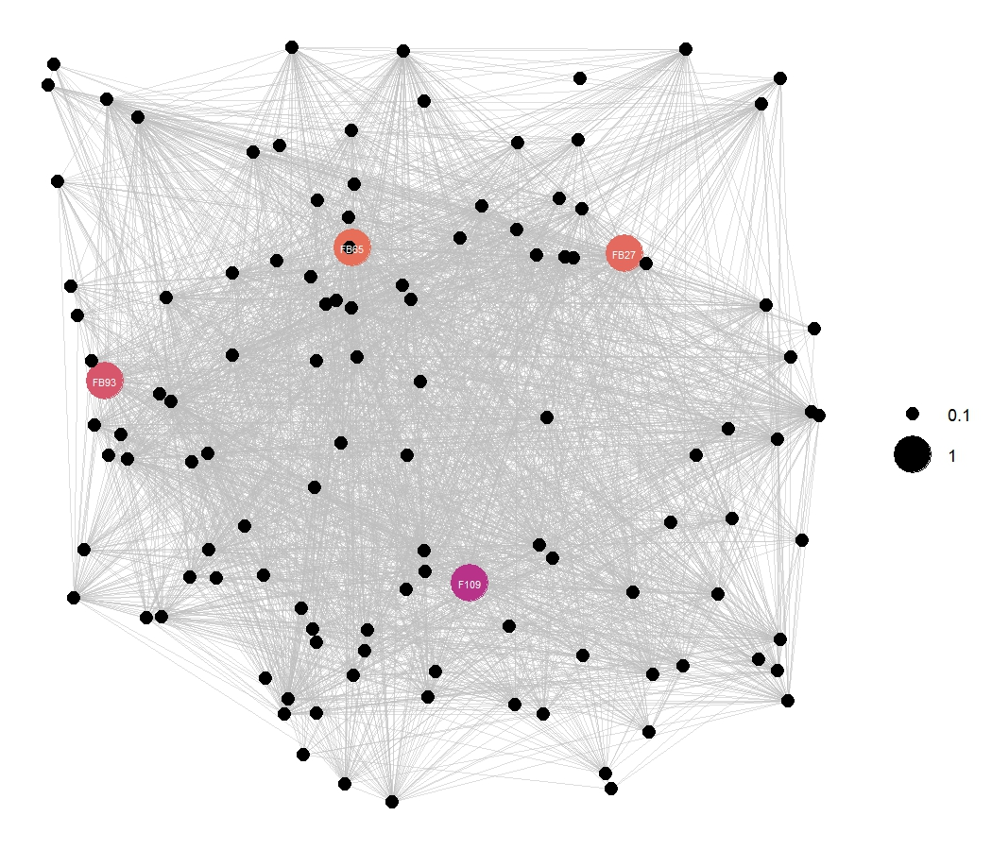
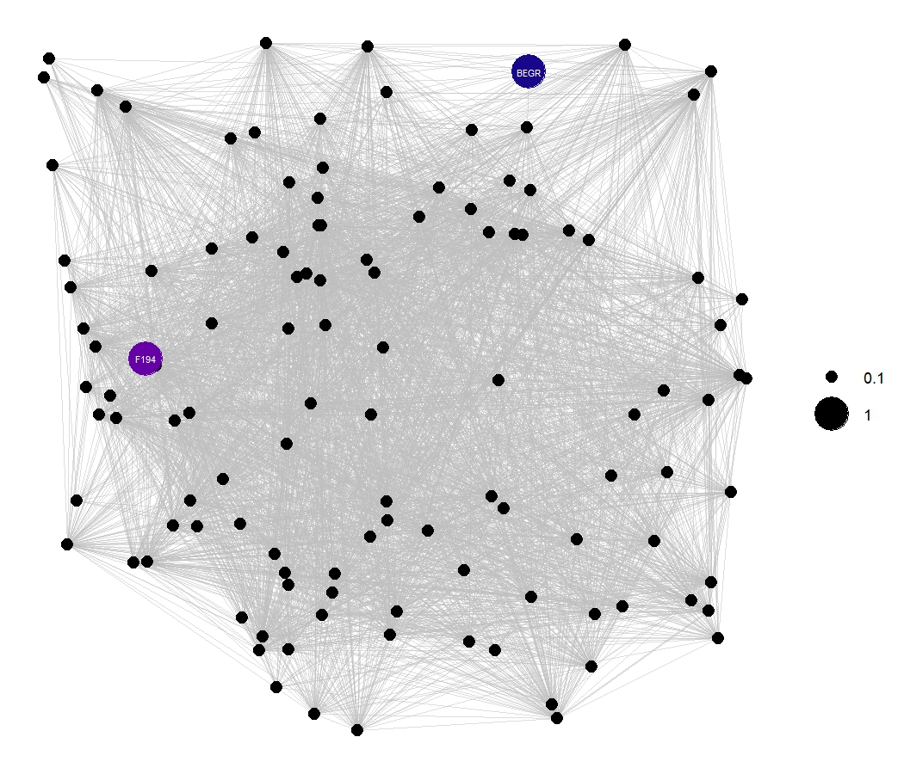
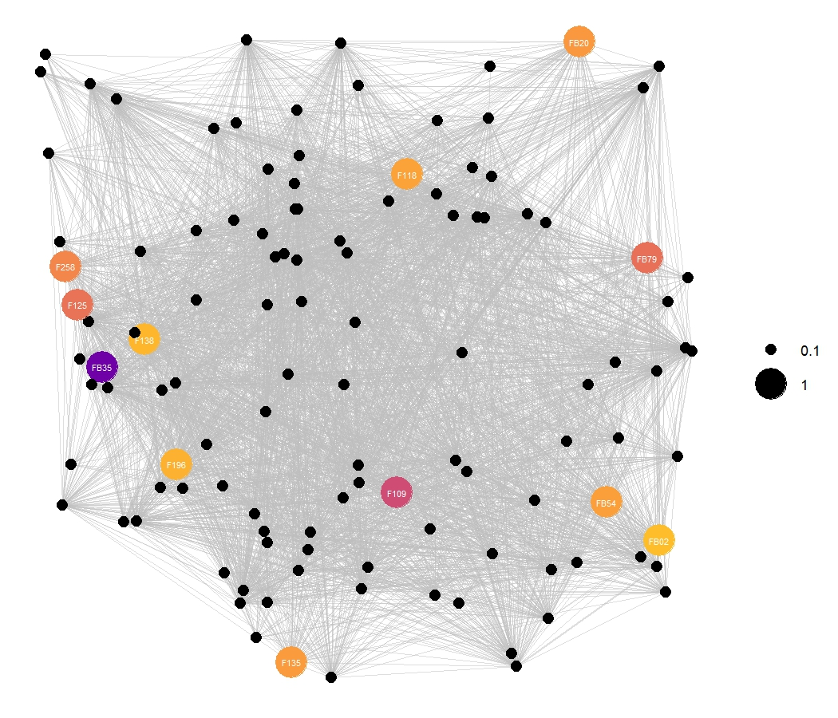
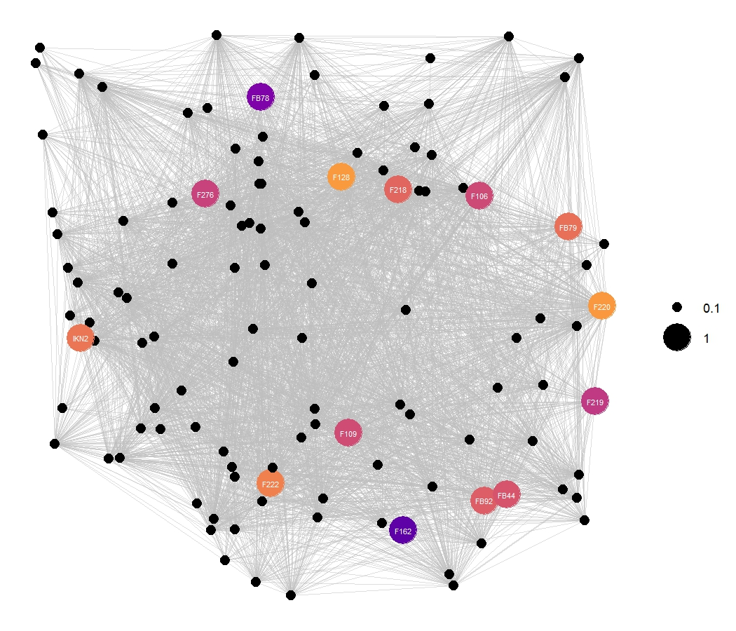
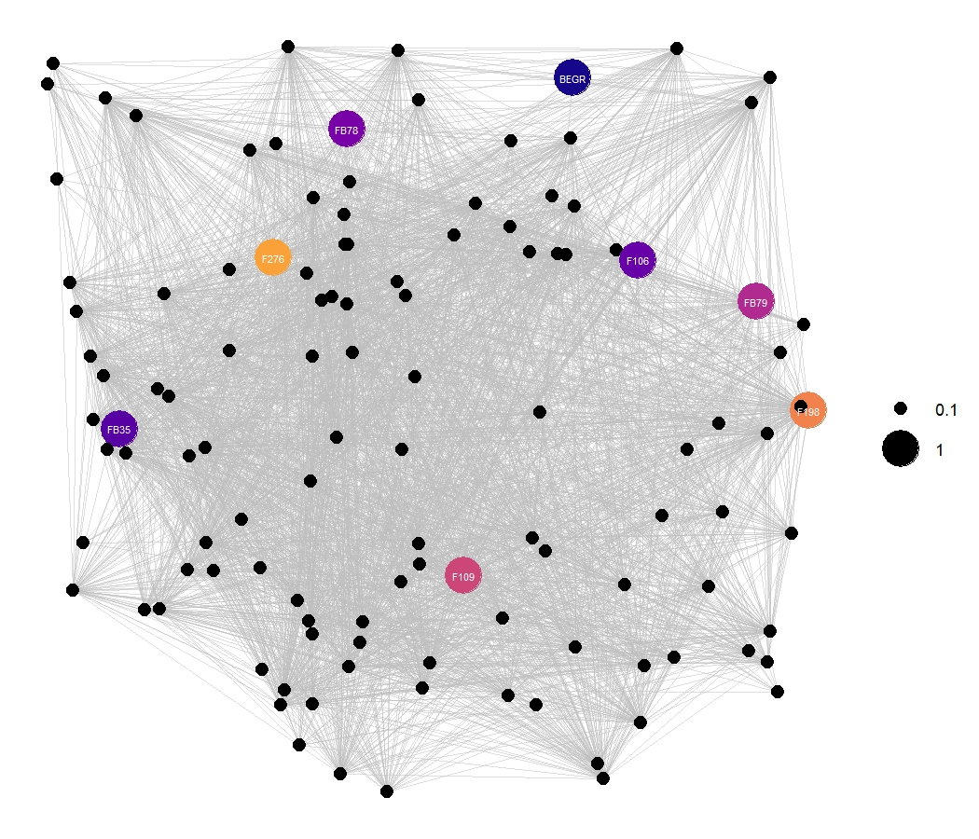
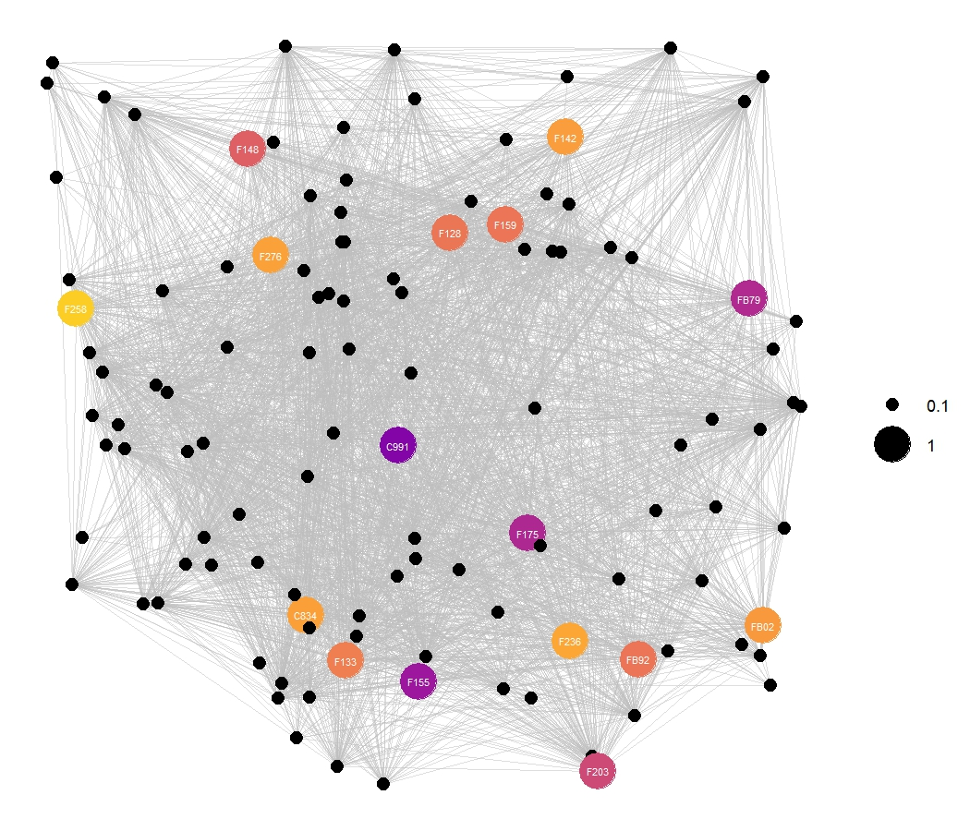
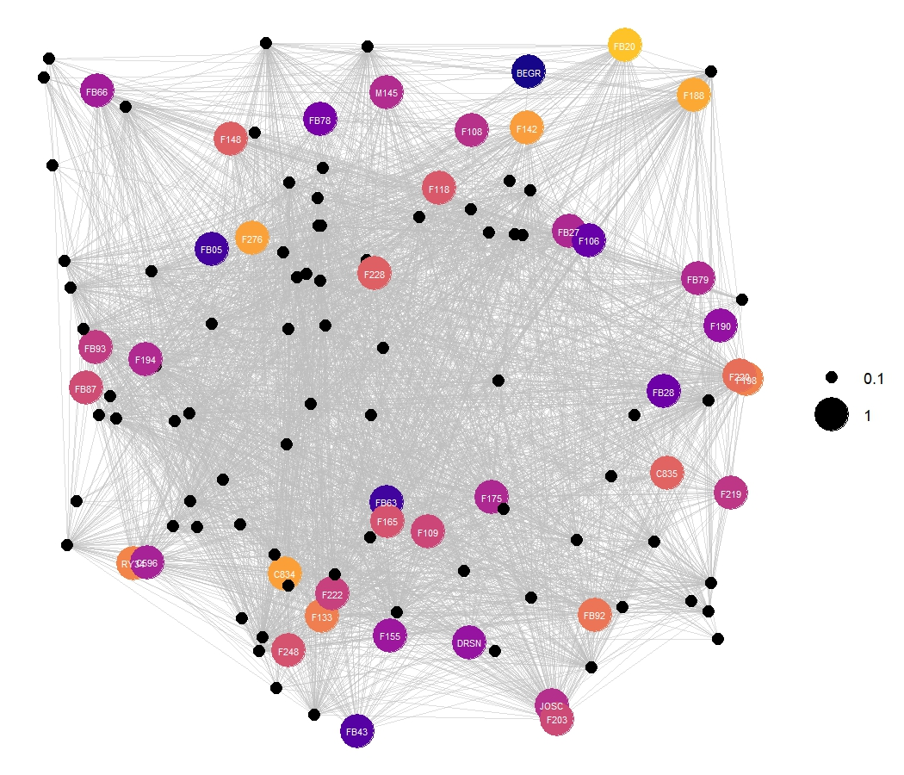
Beggars/Provisioners
Fixed gear foragers
Scavengers/Depredators
Before
Social
Centrality
During
After

Slide 9
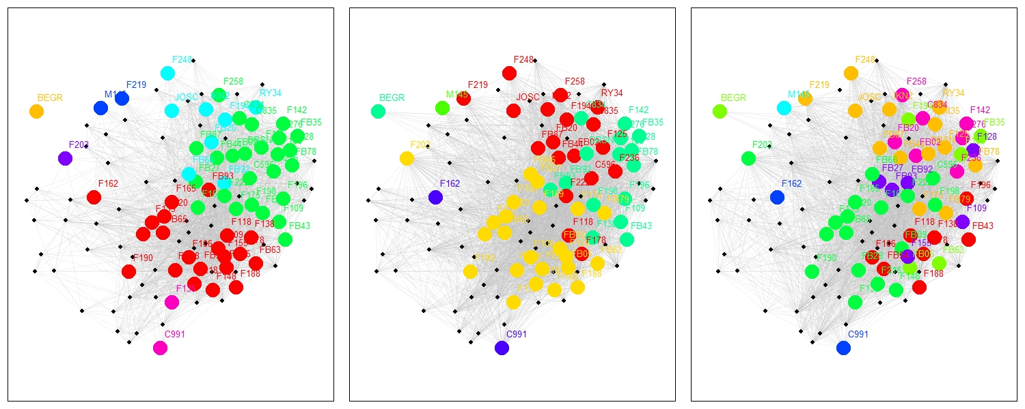
Before
During
After
Total Clusters = 8
Human-centric Clusters = 7
Total Clusters = 7
Human-centric Clusters = 4
Total Clusters = 8
Human-centric Clusters = 8

Slide 10
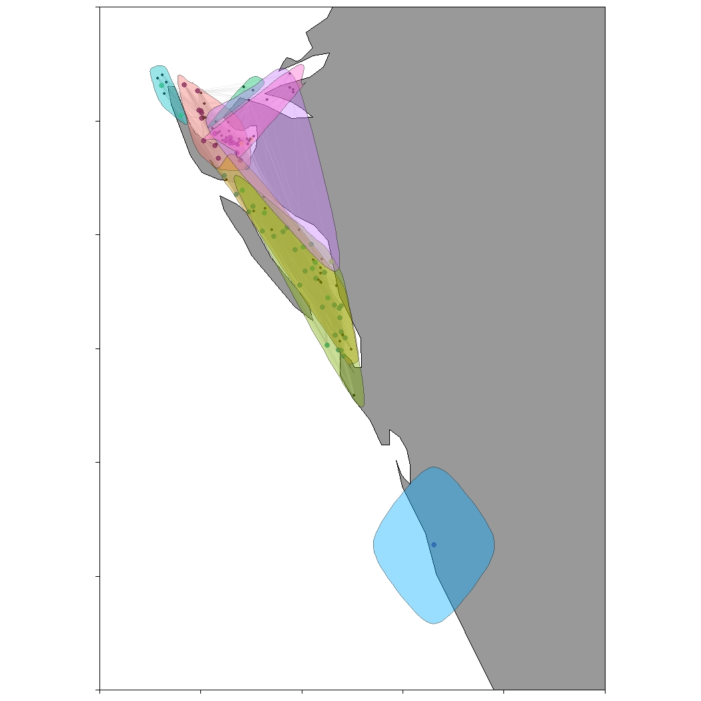
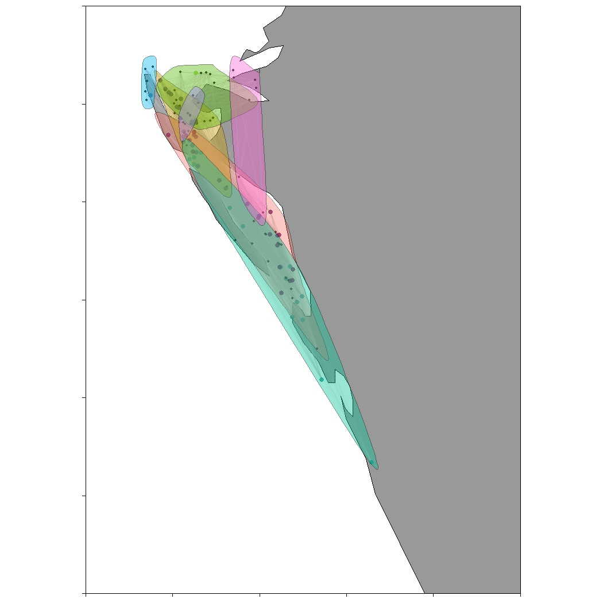
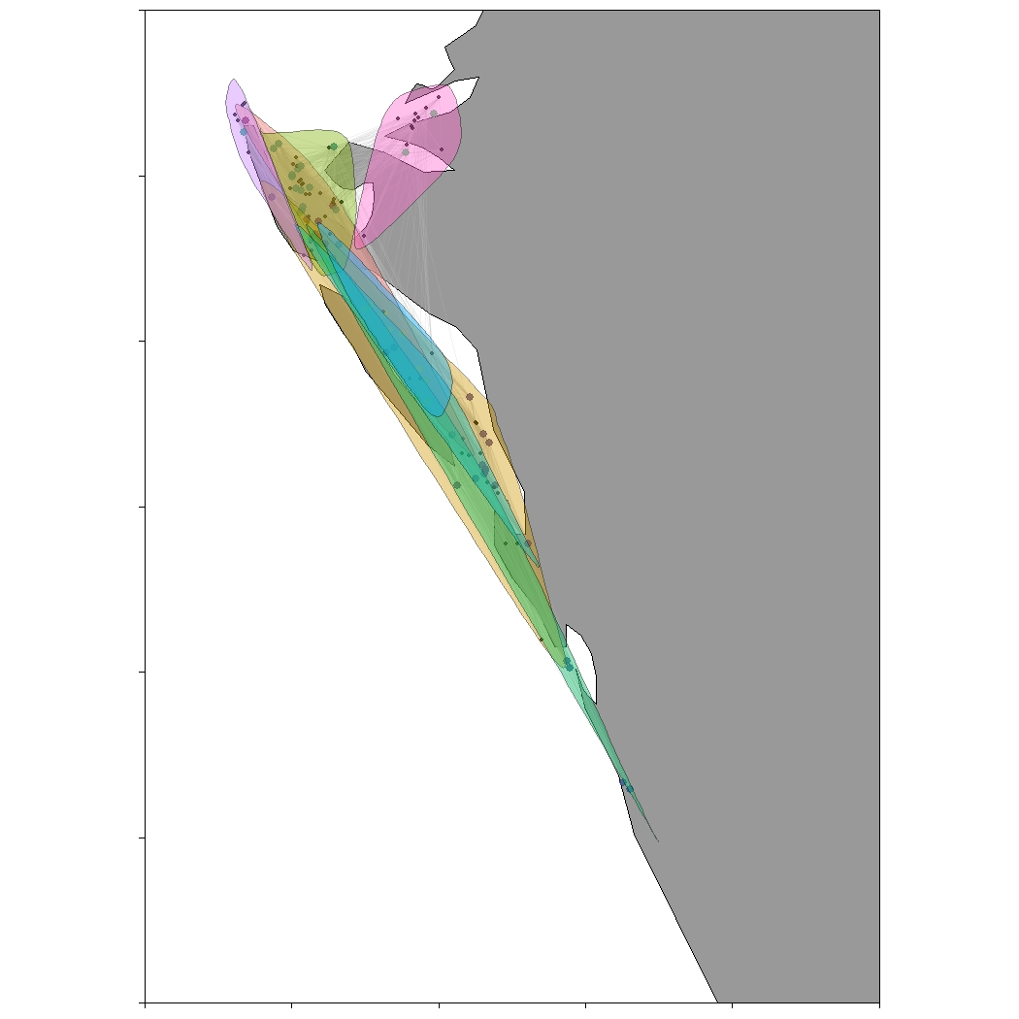
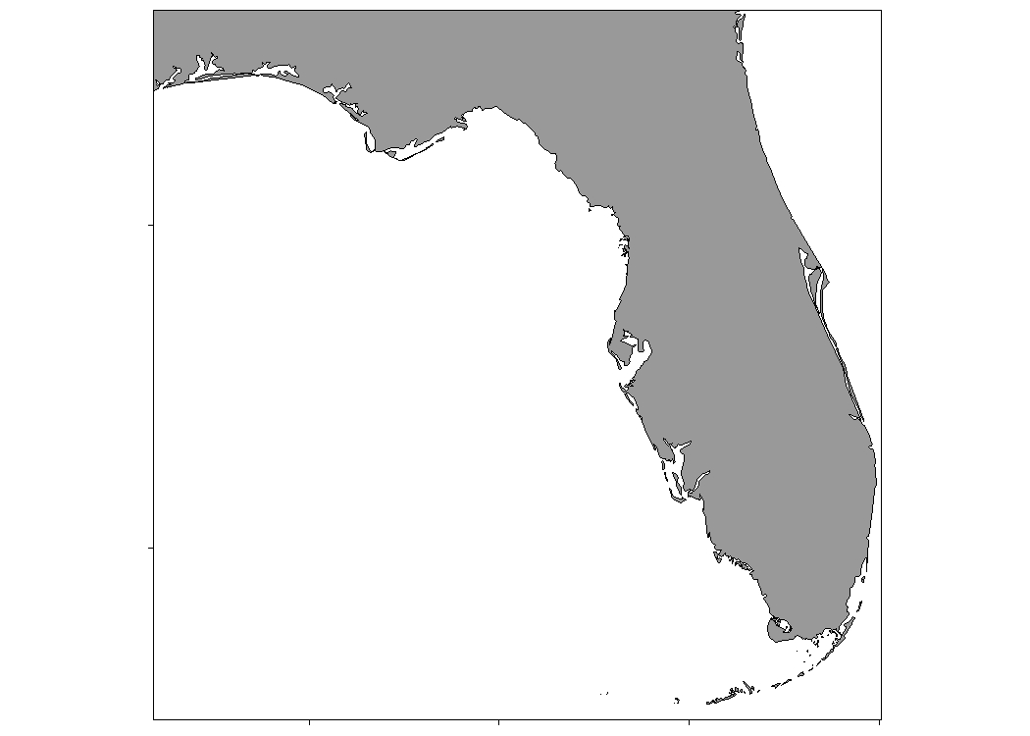
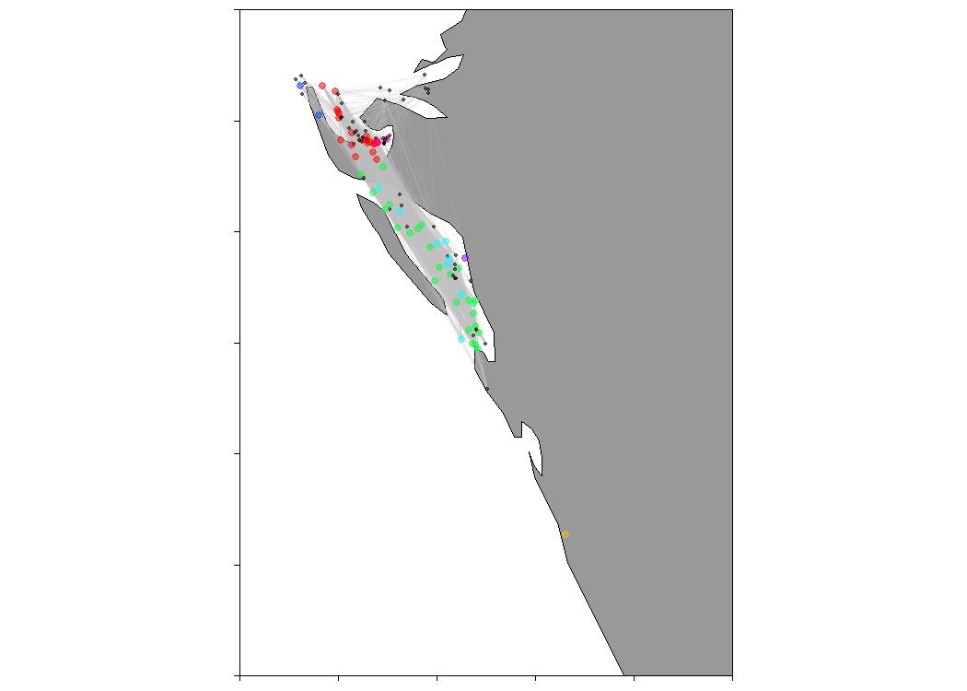
Before
During
After
27.6°N
27°N
27.6°N
27°N
27.6°N
27°N
FLORIDA
FLORIDA
FLORIDA
SARASOTA
SARASOTA
SARASOTA
-82.8°E 82.3°E
-82.8°E 82.3°E
-82.8°E 82.3°E

Slide 11
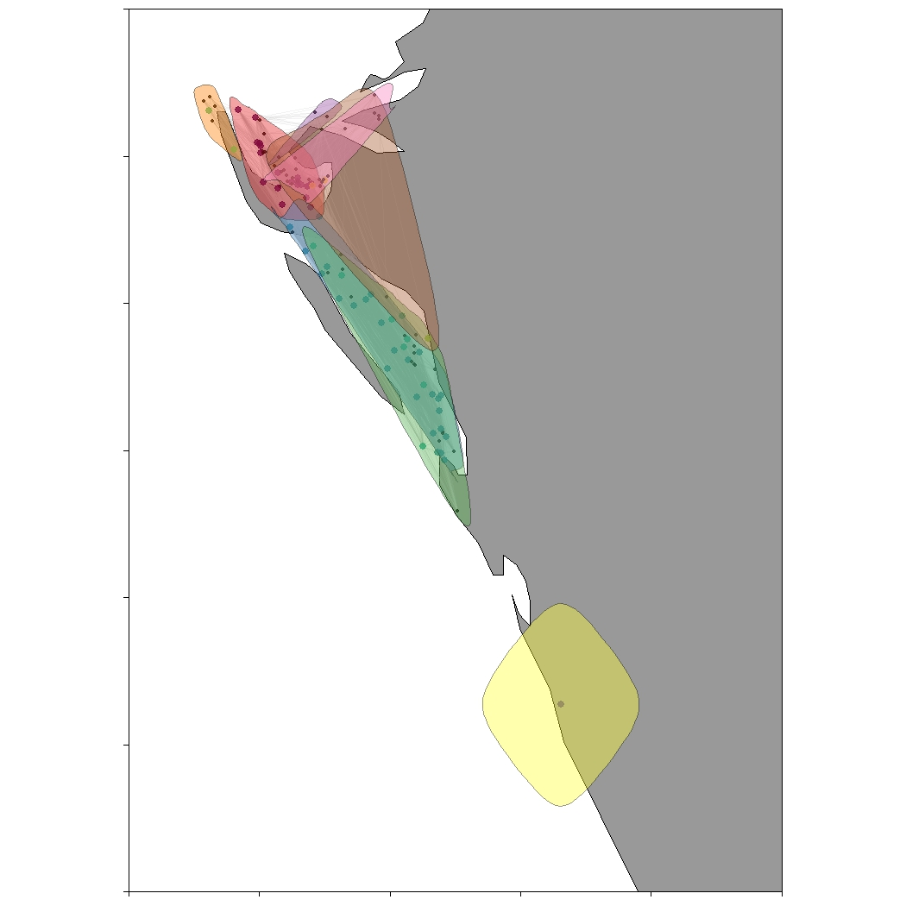
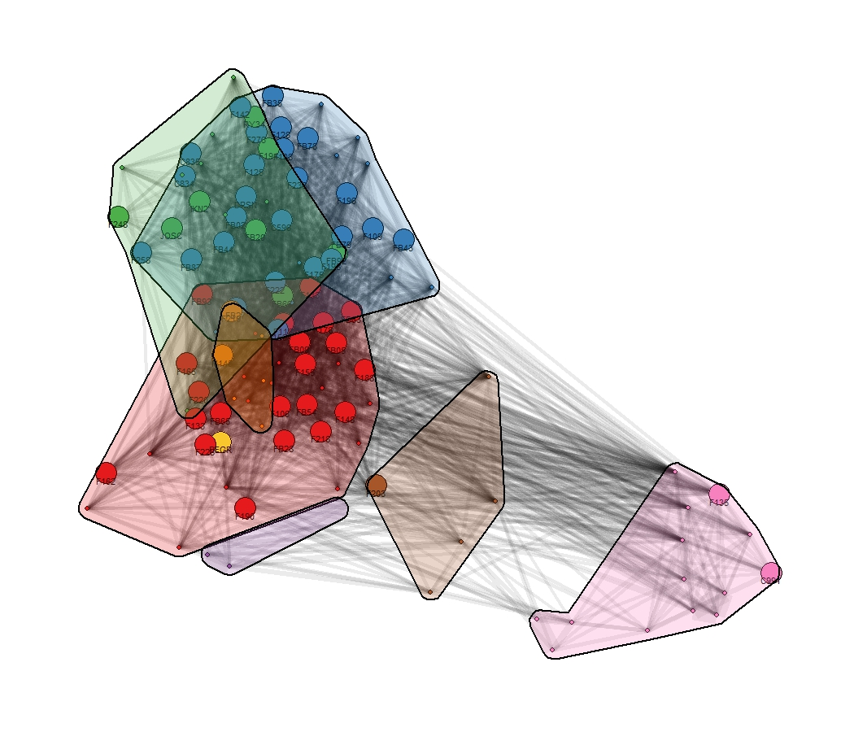
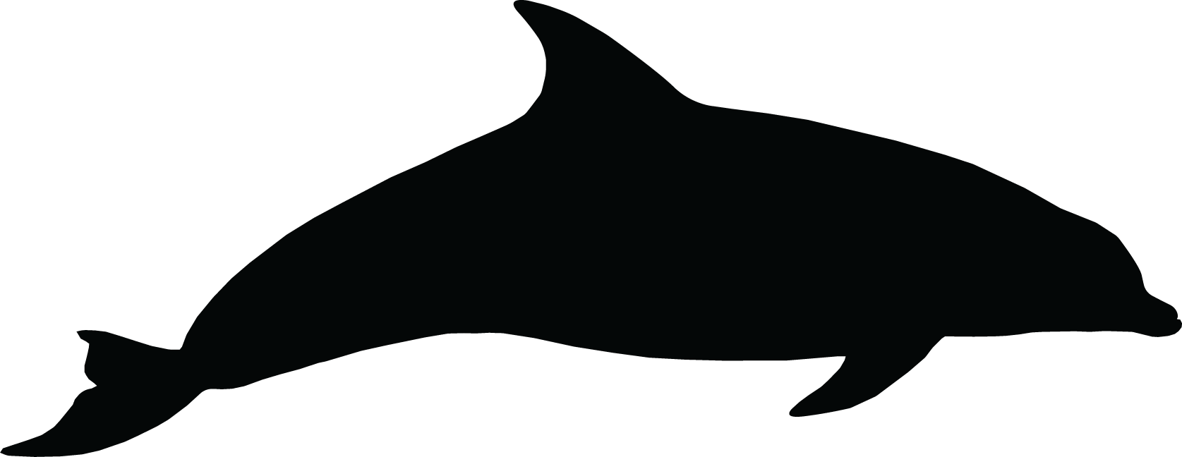
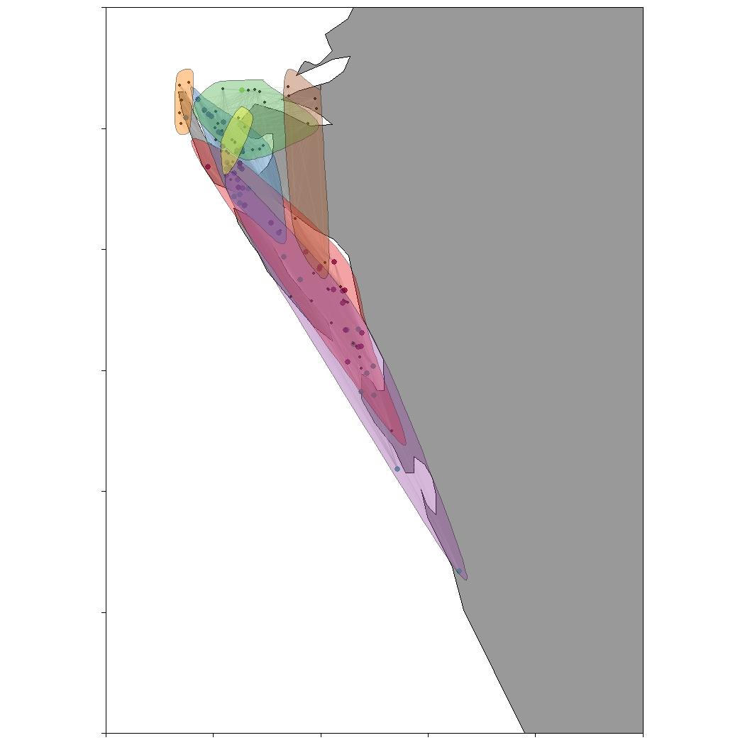
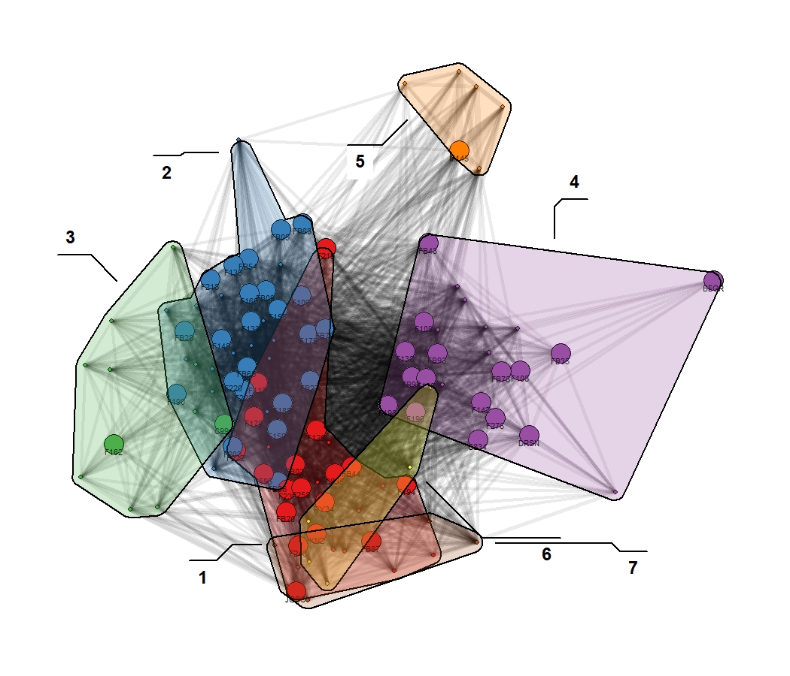
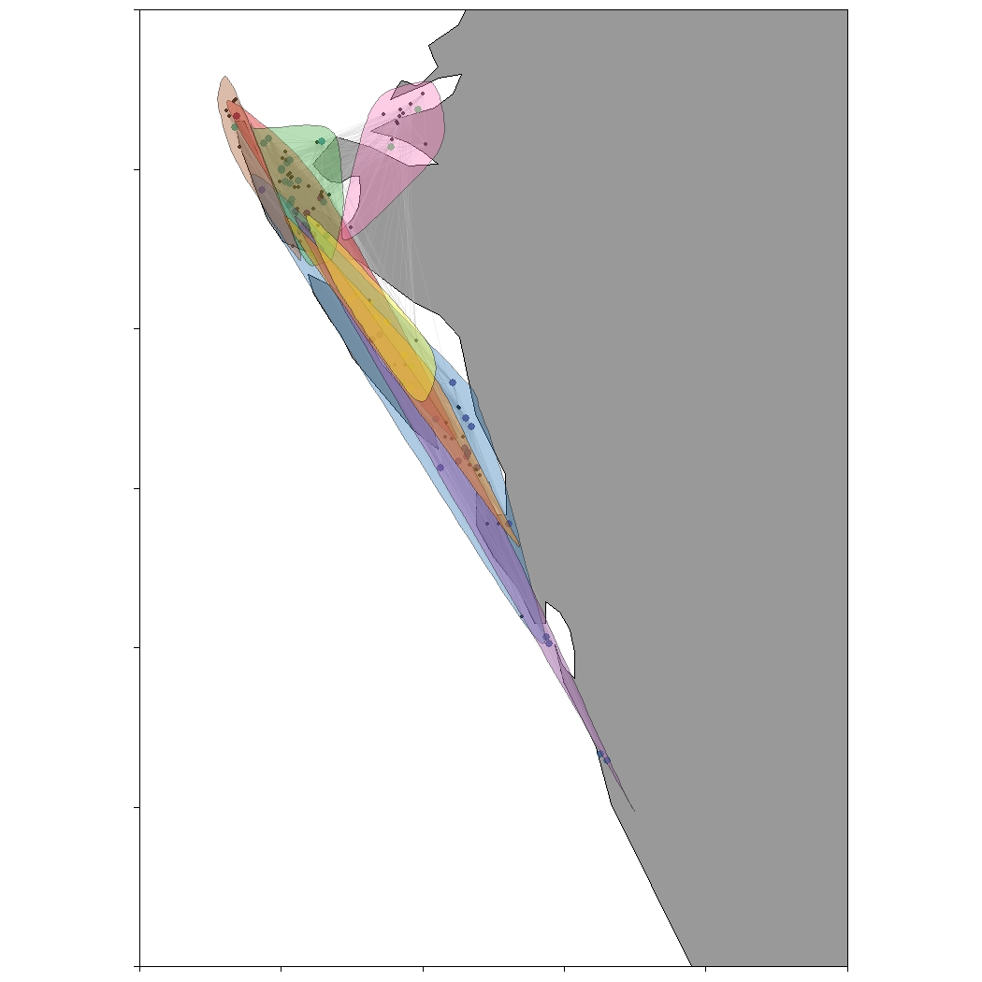
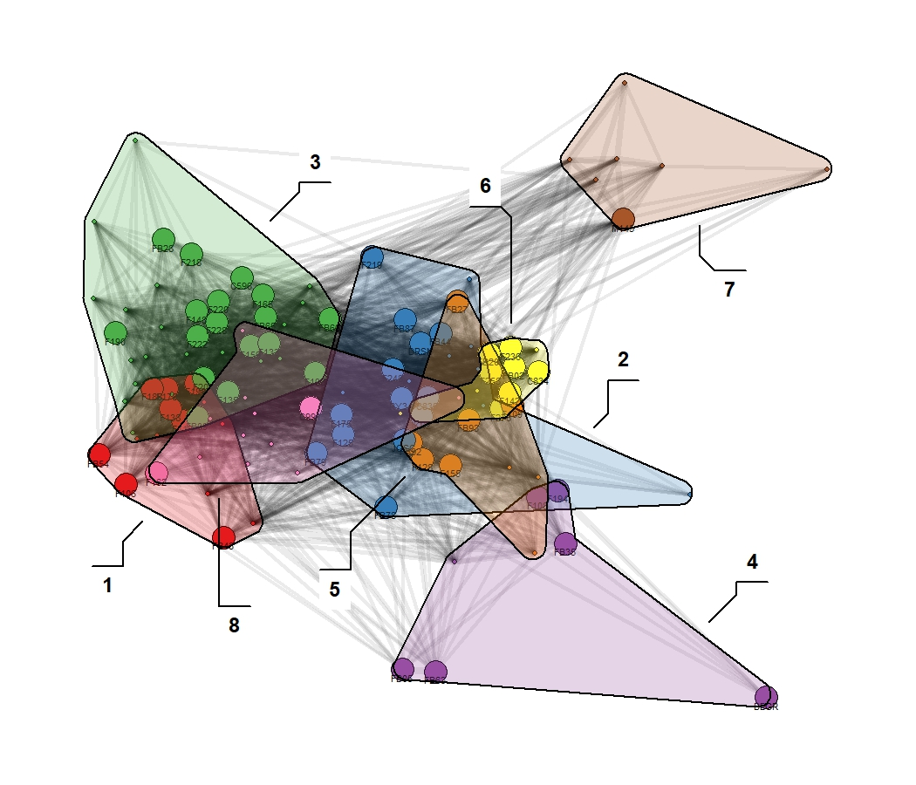
27.6°N
27°N
FLORIDA
3
2
SARASOTA
5
Before
7
6
8
1
4
27.6°N
27°N
FLORIDA
SARASOTA
During
27.6°N
27°N
FLORIDA
SARASOTA
After
-82.8°E 82.3°E

Slide 12
Before
During
After
3
2
5
6
7
8
1
4

Slide 13
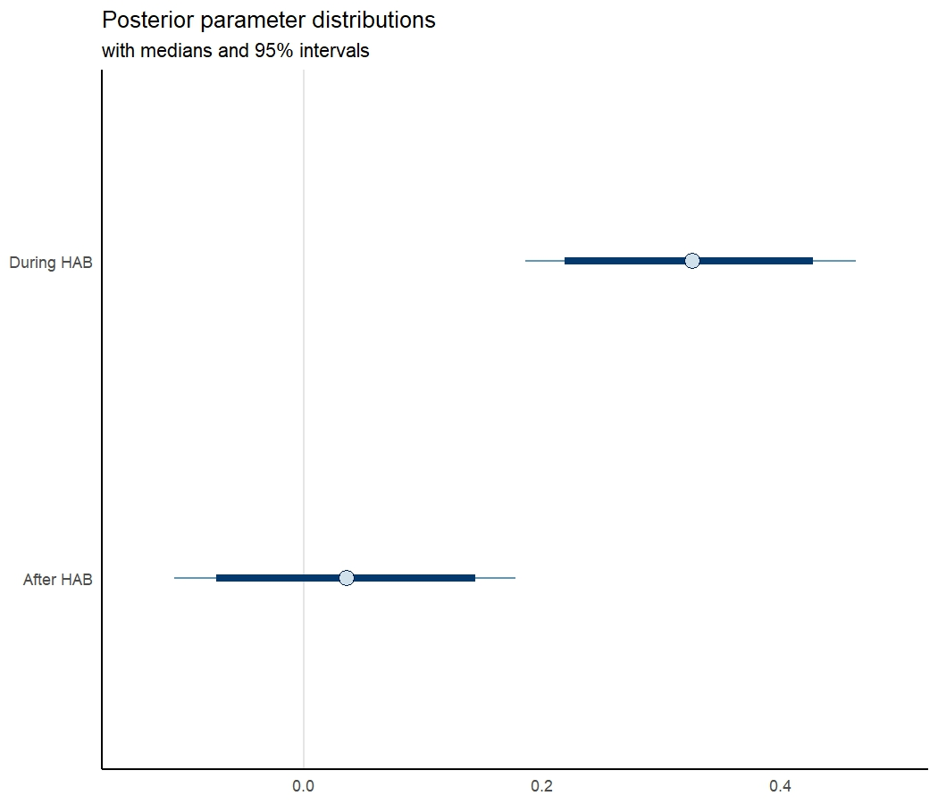
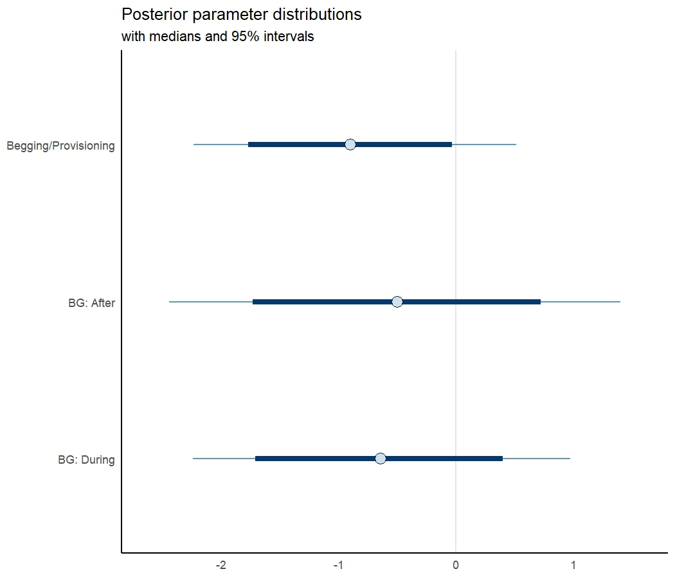
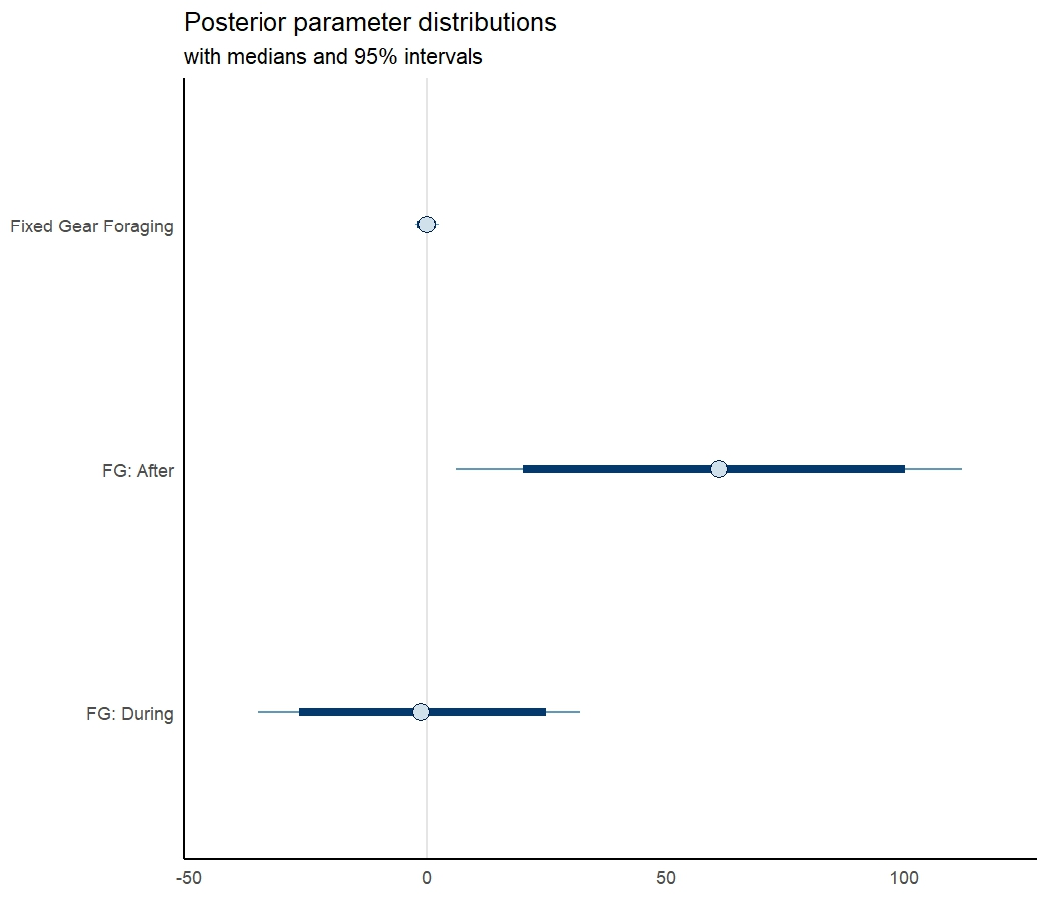
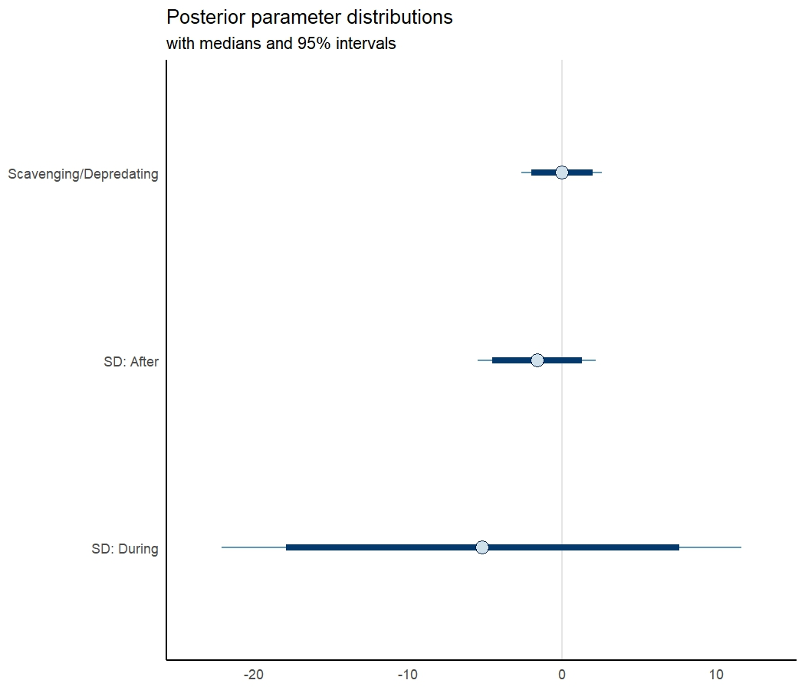
A
B
C
D

Slide 14
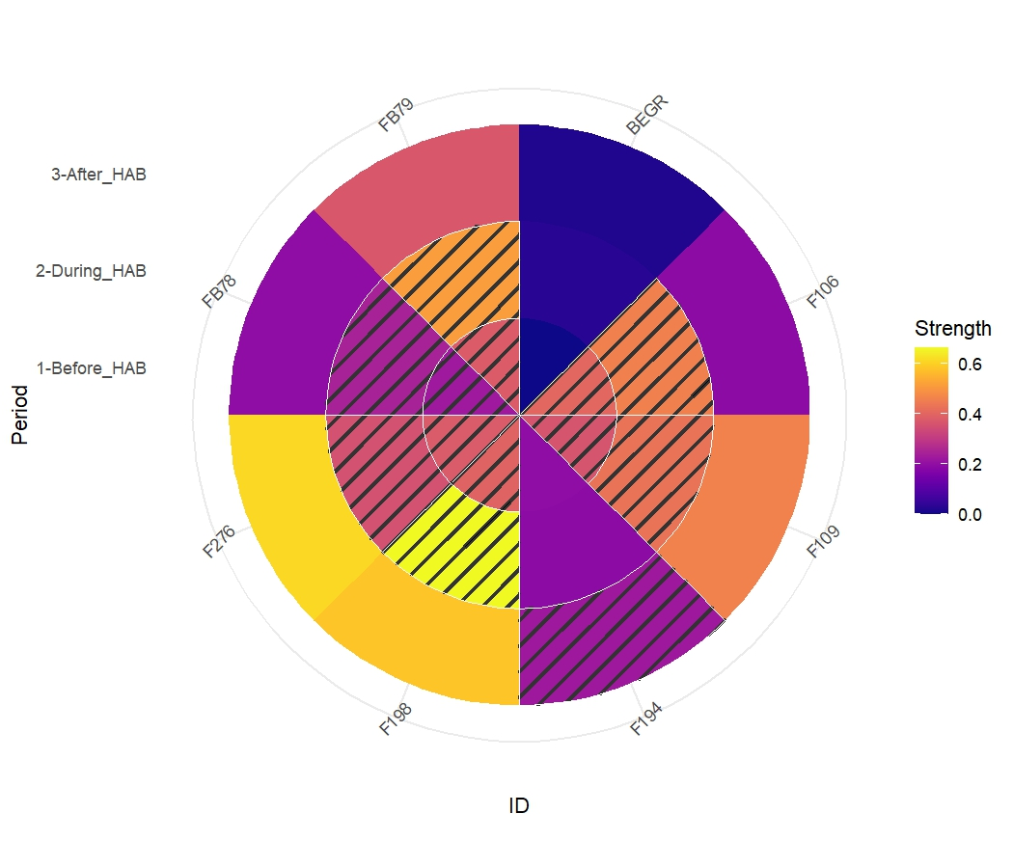
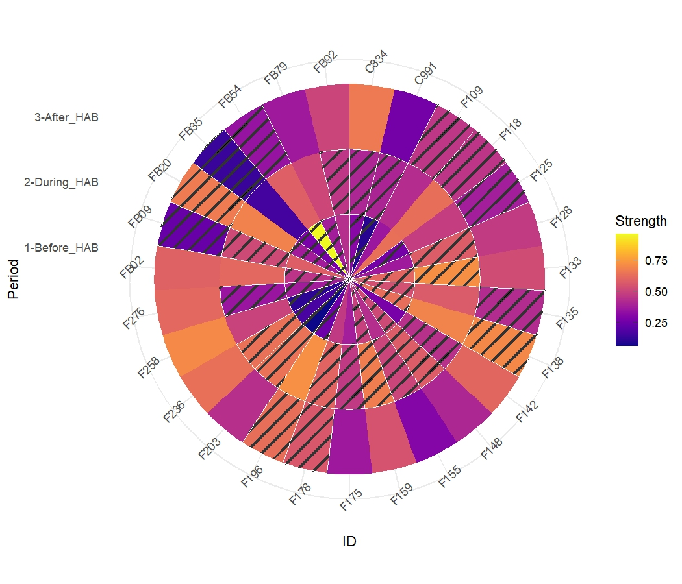
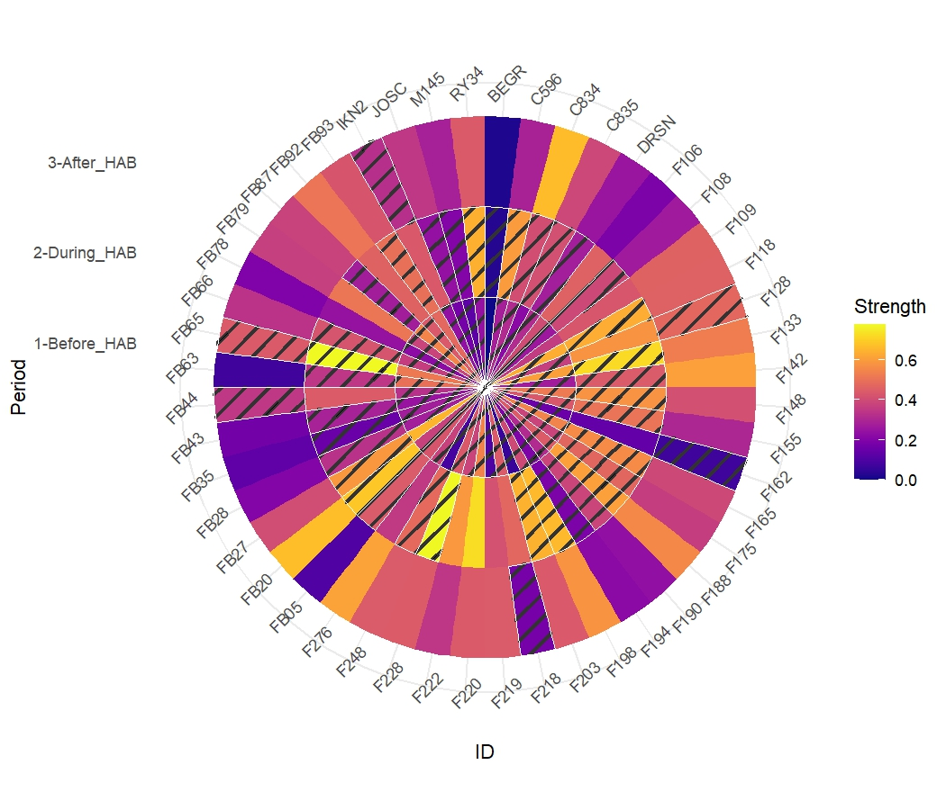
A
B
C

